Slide 1
Sikkerhet og Informasjons-beskyttelse med Microsoft 365
JAN VIDAR ELVEN @SKILLRIVER Oddvar Moe @ODDVARMOE

Slide 2

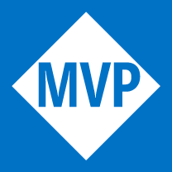

JAN VIDAR ELVEN
ARKITEKT MODERNE DATAROM, SKILL AS
MVP ENTERPRISE MOBILITY
BLOGG: HTTPS://GOTOGUY.BLOG
FOTBALL, SKI, NATUR OG HYTTA!

Slide 3



ODDVAR MOE
MVP – CLOUD AND DATACENTER MANAGEMENT
CHIEF TECHNICAL ARCHITECT @Advania
Blogger – https://Oddvar.moe
SECURITY GEEK – PENTESTING / HARDENING / SECURITY RESEARCH
LOLBAS project – lolbins.com / lolbas-project.com
Ultimate AppLocker Bypass List
CVE-2017-8625
MEMES AND GIFS

Slide 4
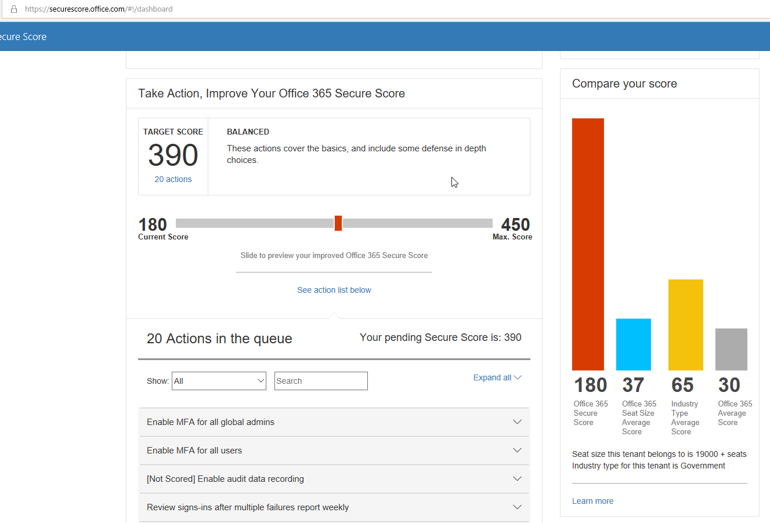
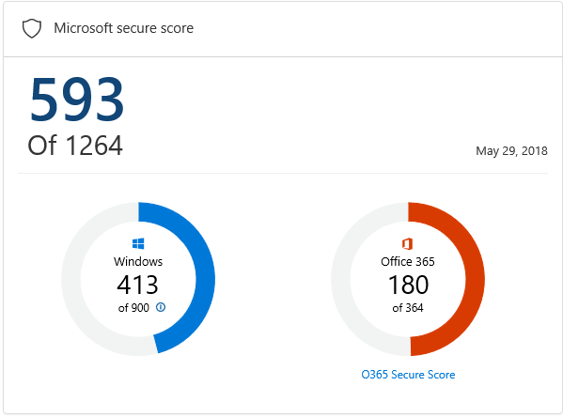
Dagens hotte tips
Notes:
OM
https://securescore.office.com/

Slide 5
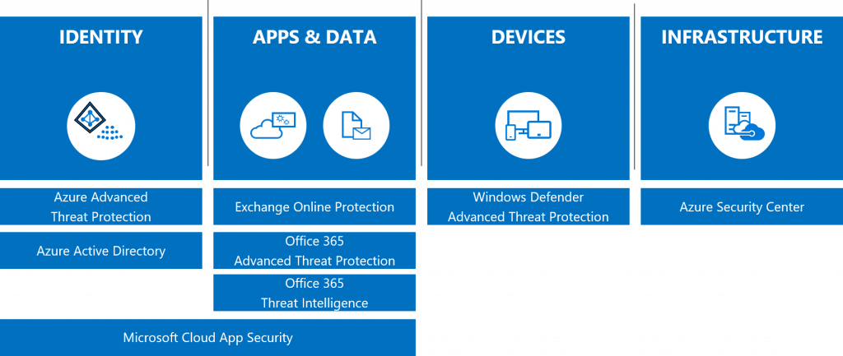
Securing the Modern Workplace
Notes:
JVE

Slide 6
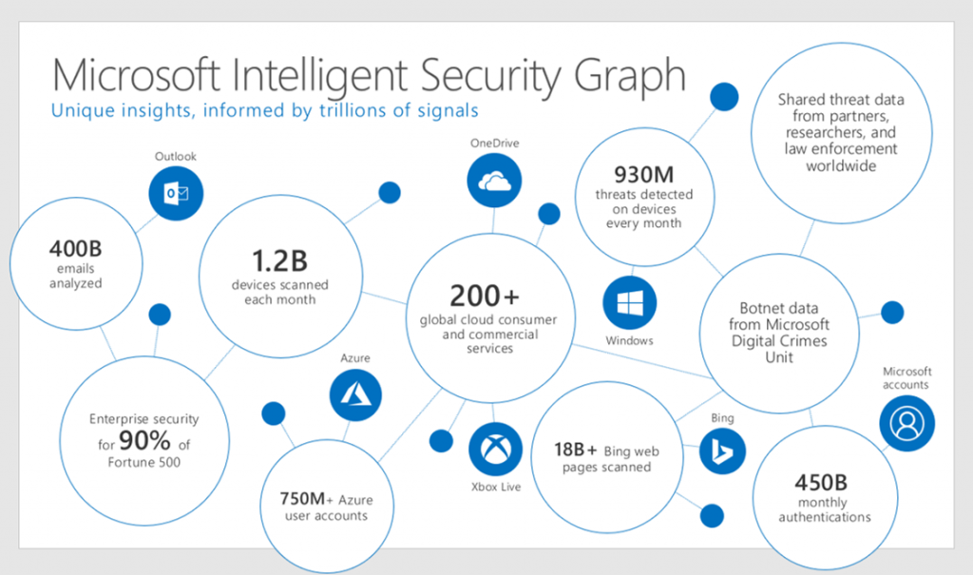
Intelligent Security Graph
Notes:
All our security capabilities leverage the graph, including the threat protection services comprised of Windows Defender Advanced Threat Protection (WDATP), Office 365 Advanced Threat protection (ATP), Office 365 Threat Intelligence, Microsoft Cloud App Security, Azure Security Center, and the newly launched Azure Advanced Threat Protection (Azure ATP).

Slide 7
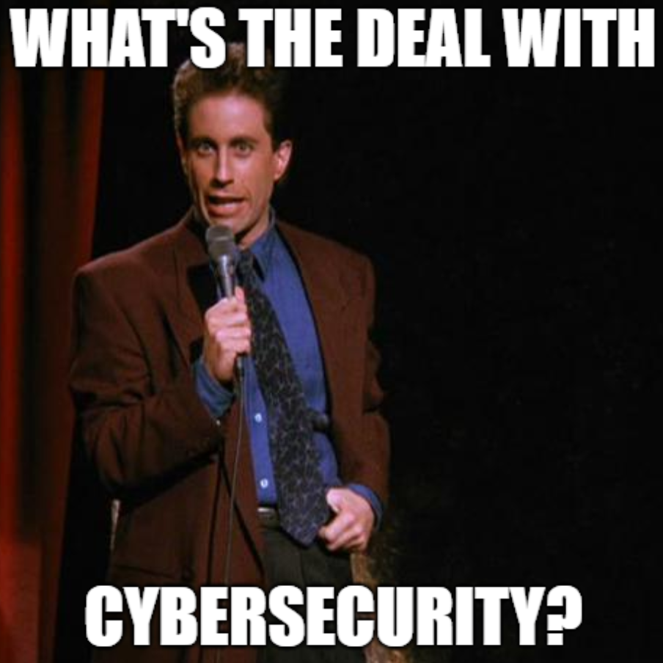

Riktig verktøy til jobben?
Notes:
JVE

Slide 8
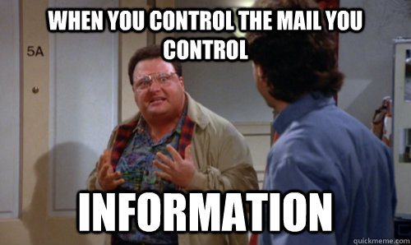
Hvilke Trusler møter vi?

Slide 9
Microsoft 365 Threat Protection
Protection
Detection
Response
Education
Notes:
JVE
Protection – against advanced threats such as 0-days, targeted phishing, ransomware, and others
Detection – when a breach has occurred, who has been breached, what data has been compromised
Response – remediate from an attack and return the organization to a no threat state
Education – end users on how to react or respond to different types of threats

Slide 10
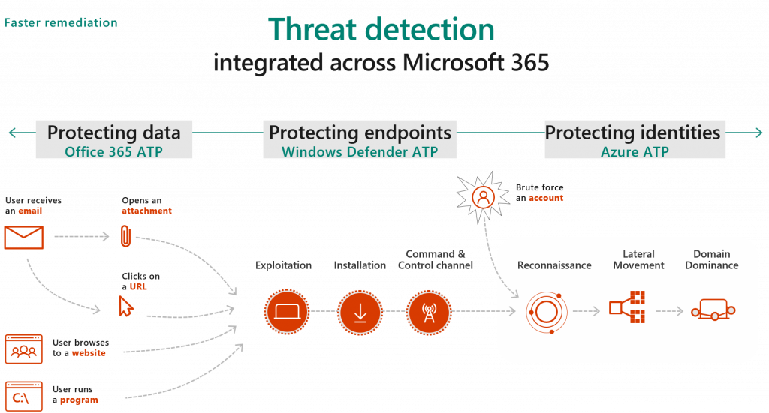
Threat detection
Notes:
JVE

Slide 11
Alt var enklere før?
users
devices
apps
data
On-premises
Notes:
JVE

Slide 12







Færre grenser, mer data, mer kompleksitet
OPPORTUNITY
On-premises
Notes:
JVE
Nå er det færre grenser, mer data, mer kompleksitet

Slide 13
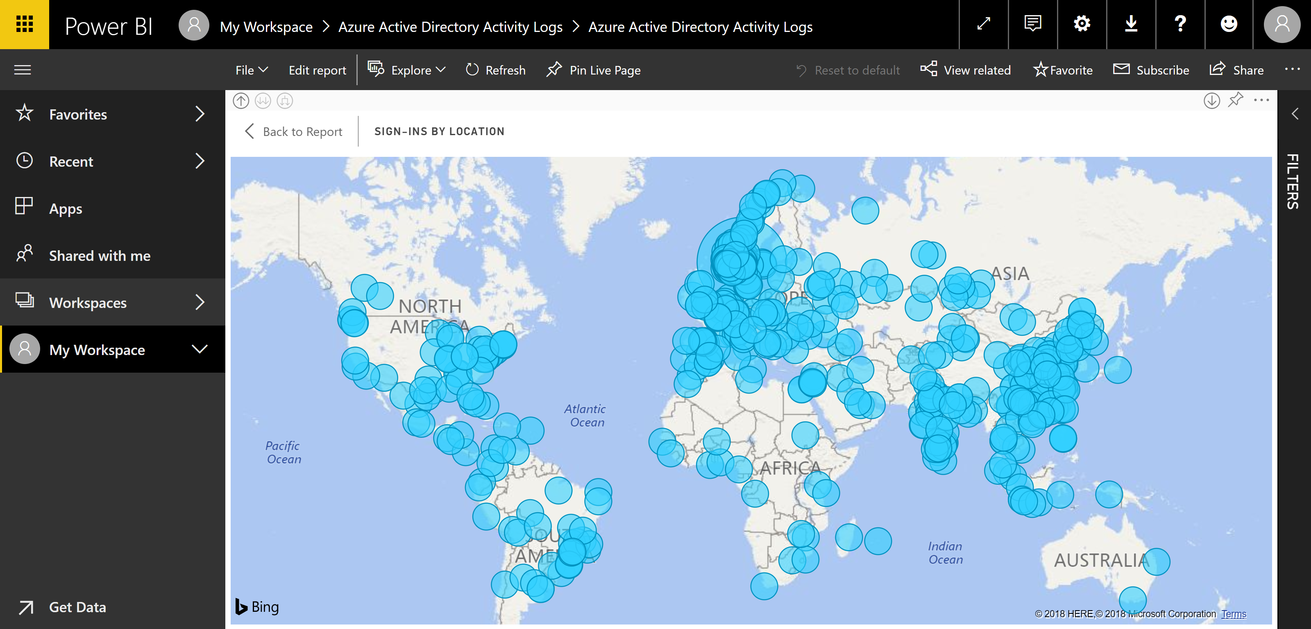
Har du kontroll på Azure AD sign ins?

Slide 14
Microsoft Information Protection Løsninger
Identity & access management
Threat protection
Information protection
Security management
Protect users’ identities & control access to valuable resources based on user risk level
Protect against advanced threats and recover quickly when attacked
Ensure documents and emails are seen only by authorized people
Gain visibility and control over security tools
Azure Active Directory
Conditional Access
Windows Hello
Windows Credential Guard
Advanced Threat Analytics
Windows Defender Advanced Threat Protection
Office 365 Advanced Threat Protection
Office 365 Threat Intelligence
Azure Information Protection
Office 365 Data Loss Prevention
Windows Information Protection
Microsoft Cloud App Security
Office 365 Advanced Security Mgmt.
Microsoft Intune
Azure Security Center
Office 365 Security Center
Windows Defender Security Center
Notes:
JVE

Slide 15
Hvordan beskytte Sensitiv Informasjon?
INFORMATION PROTECTION LIFECYCLE
Detect
Classify
Protect
Monitor
Scan & detect sensitive data based on policy
Classify data and apply labels based on sensitivity
Apply protection actions, including encryption, access restrictions
Reporting, alerts, remediation
Notes:
JVE

Slide 16
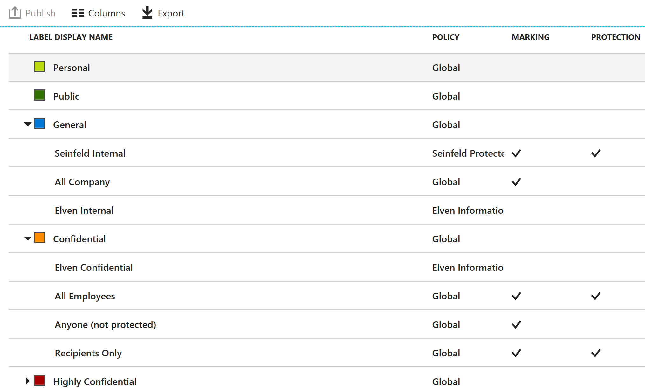
Hvordan publisere AIP Policier?
Notes:
JVE

Slide 17
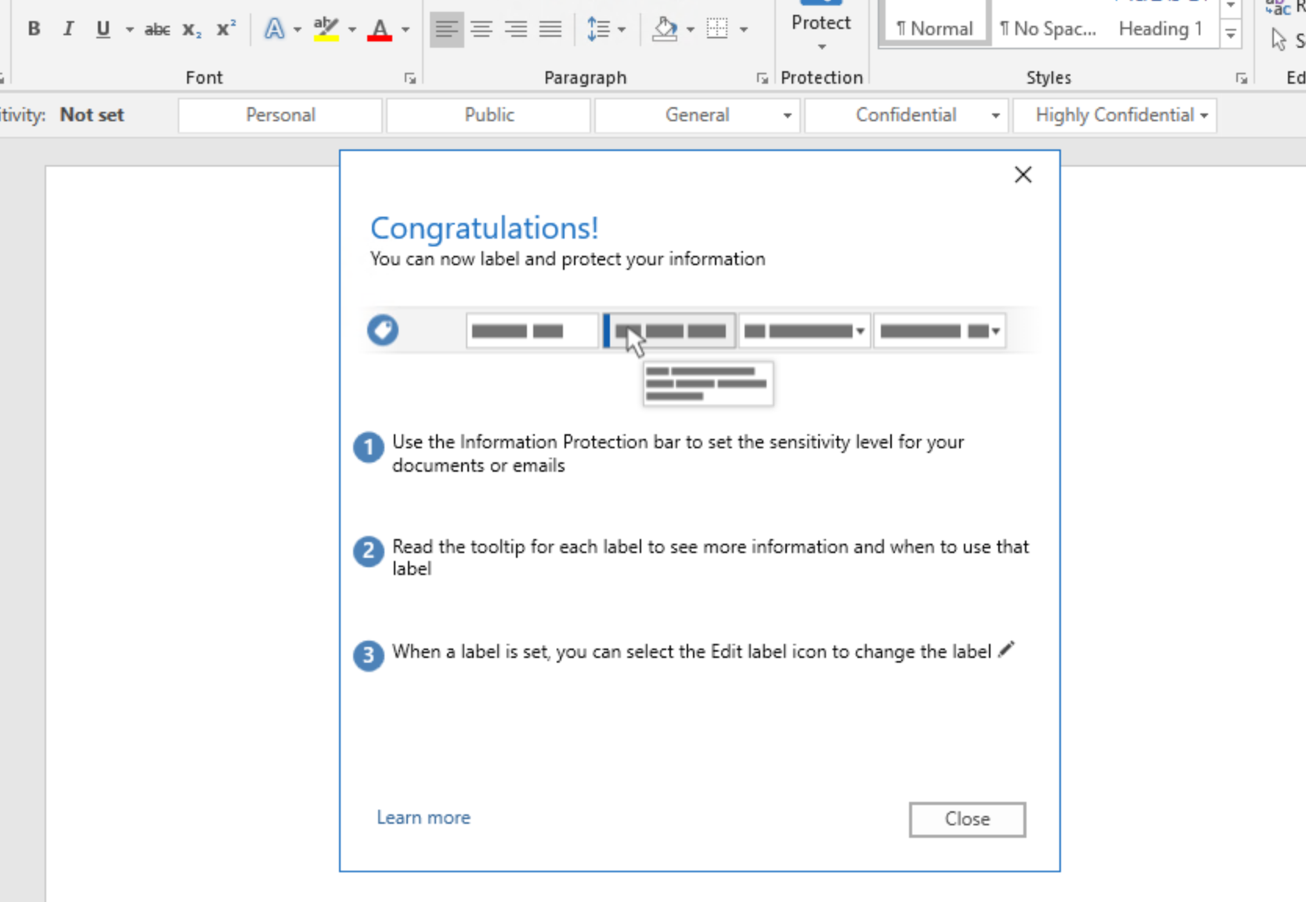
AIP KLIENT

Slide 18
Azure Information Protection Integrert med Cloud App Security
Gir mulighet for automatisk klassifisering, beskyttelse og innsikt
Krav til filer:
Word, Excel, PowerPoint, PDF + image filer (kommer)
Apps
Box, G Suite, SharePoint Online and OneDrive for Business
Begrensninger
Filer med klassifiseringsetikett og beskyttelse utenfor Cloud App Security
Notes:
JVE
https://docs.microsoft.com/en-us/cloud-app-security/azip-integration
Krever Cloud App Security og Azure Information Protection Premium P2
Word: docm, docx, dotm, dotx
Excel: xlam, xlsm, xlsx, xltx
PowerPoint: potm, potx, ppsx, ppsm, pptm, pptx
PDF and image files will be available in future versions
More Cloud Apps will be supported in future versions
Files that were labeled with protection outside of Cloud App Security cannot currently be scanned or changed by Cloud App Security

Slide 19
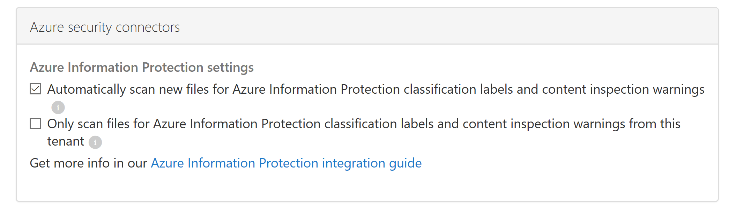
CAS: Hvordan aktivere scan av nye filer?
Notes:
JVE

Slide 20
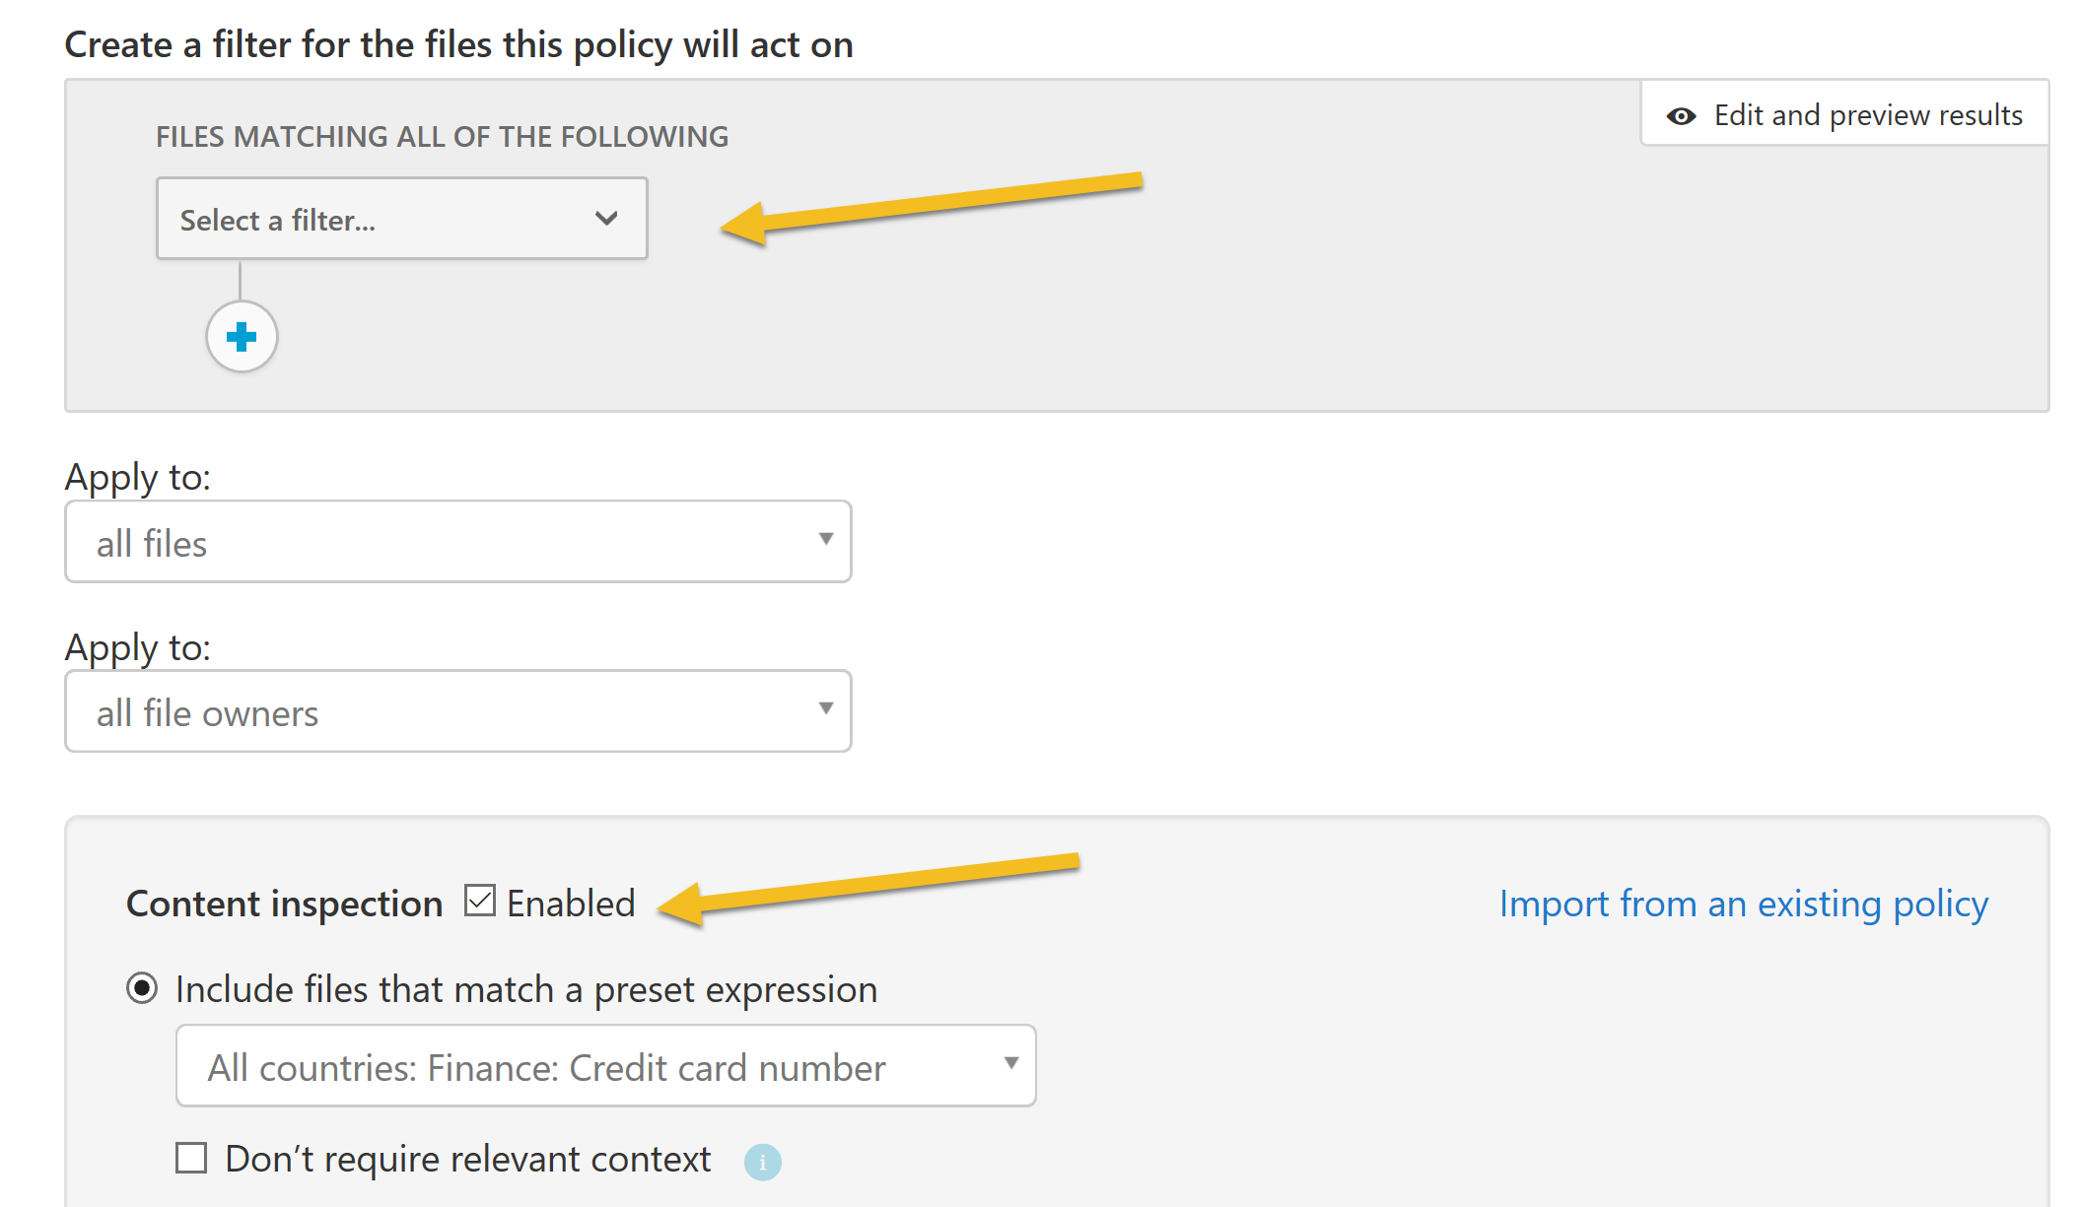
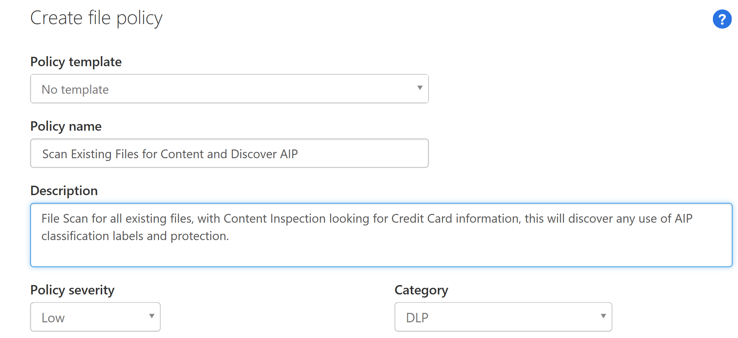
Hvordan oppdage eksisterende filer, via file policy scan:
Notes:
JVE

Slide 21
CAS Proxy for Azure AD Apps (Preview)
Gir mulighet for monitorering og tilgangskontroll for cloud apps via Azure AD Conditional Access og CAS som Proxy
Kontrollmuligheter som:
Block on download
Protect on download
Restrict user sessions from non-corporate networks
Block access
Støtter:
SAML single sign-on apps (featured)
Office 365 apps per nå ikke støttet
Notes:
https://docs.microsoft.com/en-us/cloud-app-security/proxy-deployment-aad
Krever Azure AD Premium P2 + Cloud App Security
Session control is available for any browser on any major platform (mobile apps and desktop apps are currently not supported). By natively integrating with Azure AD, any apps that are configured with SAML single sign-on in Azure AD can be supported, including the following featured apps:
Salesforce
Box
G Suite
Workday
Slack
Workplace by Facebook
ServiceNow
JIRA/Confluence
AWS
Workiva
CornerStone on Demand
DocuSign
HighQ
Concur
Block on download: You can block the download of sensitive documents. For example, on unmanaged devices.
Protect on download: Instead of blocking the download of sensitive documents, you can require documents to be protected via encryption on download. This ensures that the document is protected, and user access is authenticated, if the data is downloaded to an untrusted device.
Restrict user sessions from non-corporate networks: Users accessing a protected app from a location that is not part of your corporate network, are allowed restricted access and the download of sensitive materials is blocked or protected.
Monitor low-trust user sessions: Risky users are monitored when they sign into apps and their actions are logged from within the session. You can investigate and analyze user behavior to understand where, and under what conditions, session policies should be applied in the future.
Block access:

Slide 22
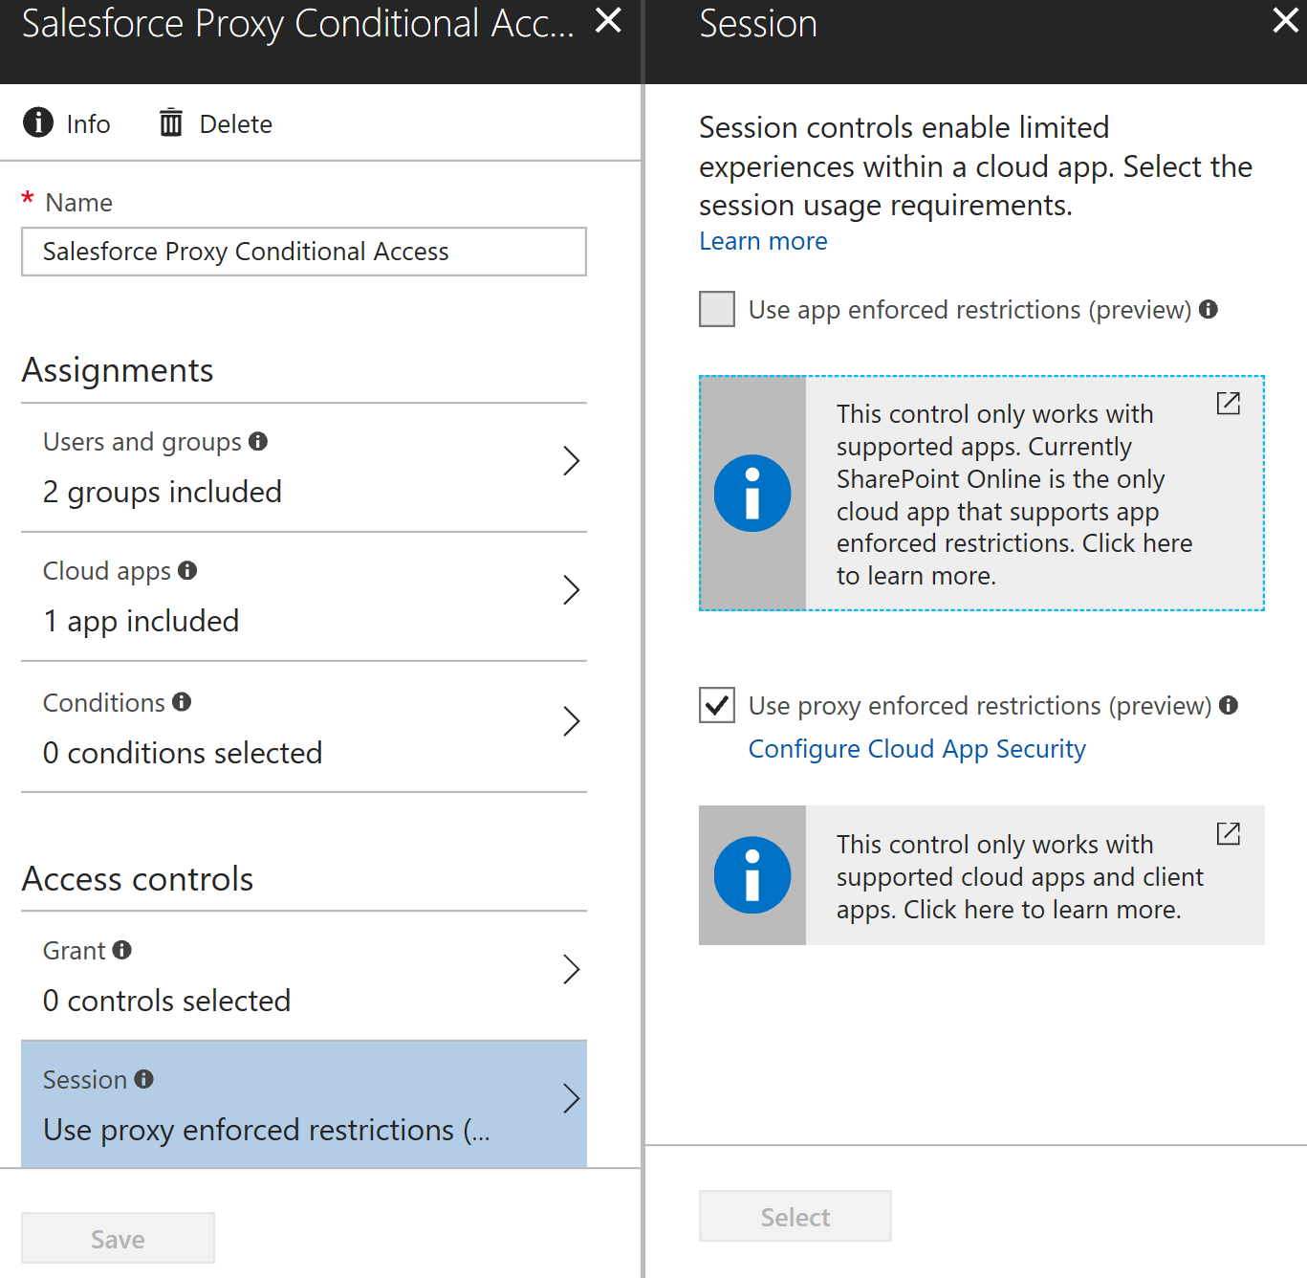
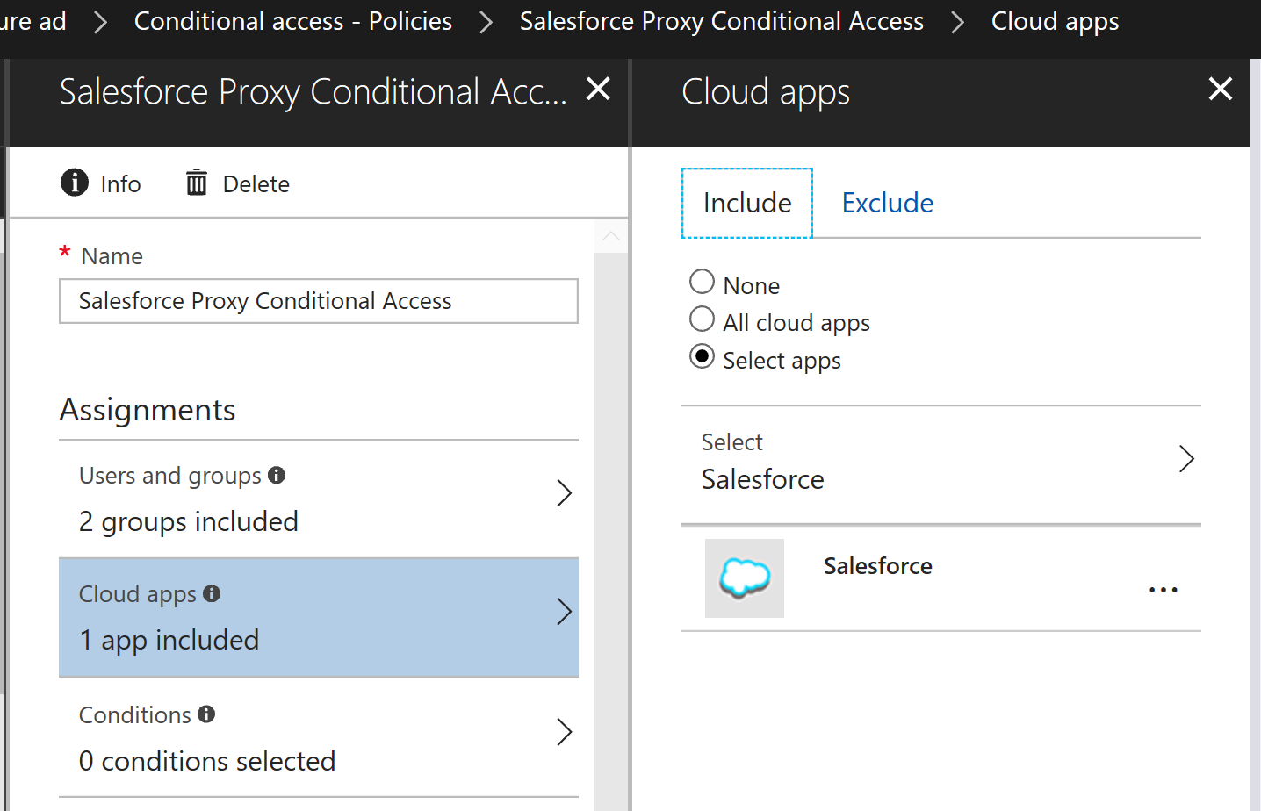
Proxy App Conditional Access

Slide 23
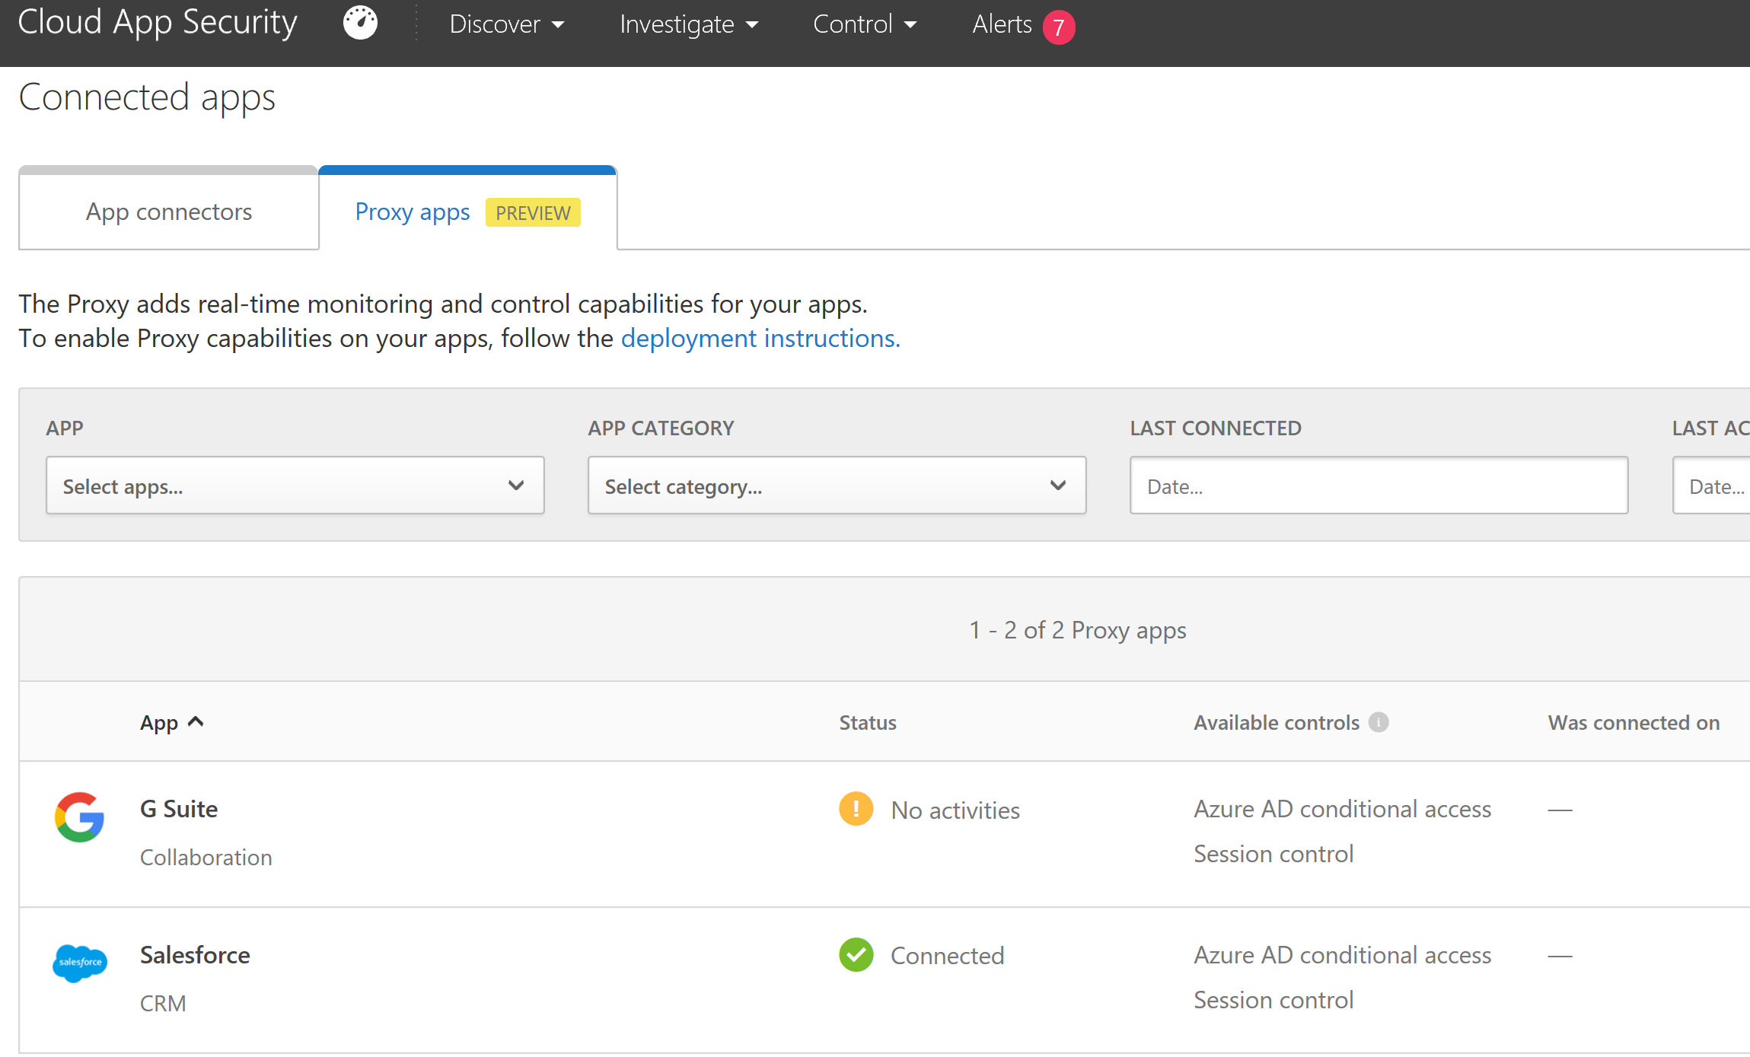
Hvordan koble Proxy Apps I CAS?

Slide 24
Hvilke Proxy App Policies har vi?
Access Policy
Real-time monitoring and control over access to cloud app
Based on user, location, device and app
Session Policy
Real-time session-level monitoring
Granular visibility with ability to take different action
Allow access while monitoring the session and/or limit specific session activities
Notes:
https://docs.microsoft.com/en-us/cloud-app-security/access-policy-aad
https://docs.microsoft.com/en-us/cloud-app-security/session-policy-aad

Slide 25
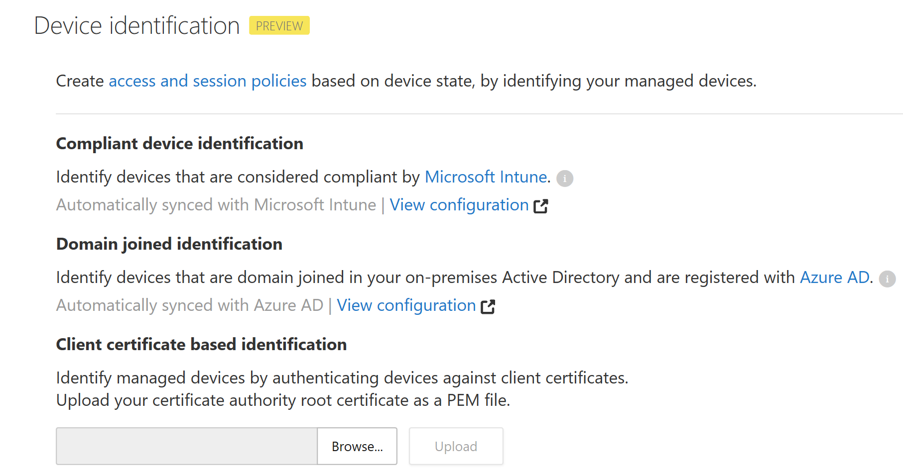
Hvordan identifisere devicer?

Slide 26
DEMO
https://aad.portal.azure.com
https://portal.cloudappsecurity.com/

Slide 27
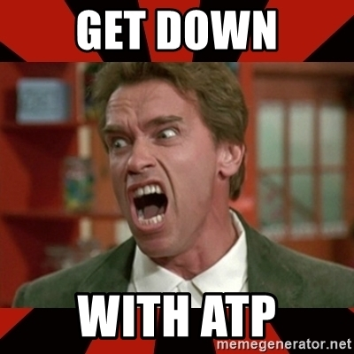
ATP MY WORLD!
Overblikk over ATP’ene
Office 365 ATP
Azure ATP
Windows Defender ATP
Notes:
Oddvar

Slide 28
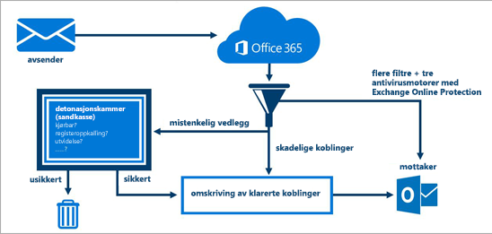
Office 365 ATP – Hva er det?
..
Notes:
Oddvar

Slide 29
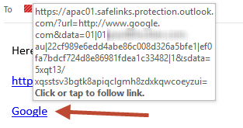
Office 365 ATP – Funker det?
Safelinks
Notes:
Outlook link conversion

Slide 30
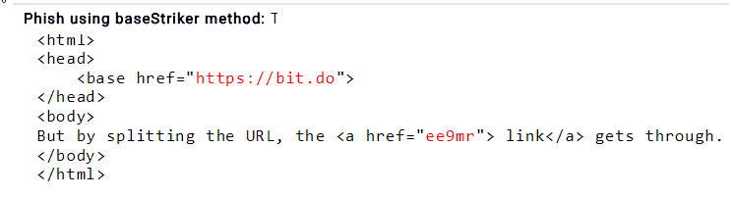
Office 365 ATP – Funker det?
Safelinks – Kjente svakheter
Avanan.com
Notes:
https://www.avanan.com/resources/basestriker-vulnerability-office-365 – Is fixed

Slide 31
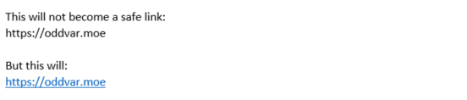
Office 365 ATP – Funker det?
Safelinks – Kjente svakheter
Notes:
Outlook link conversion

Slide 32
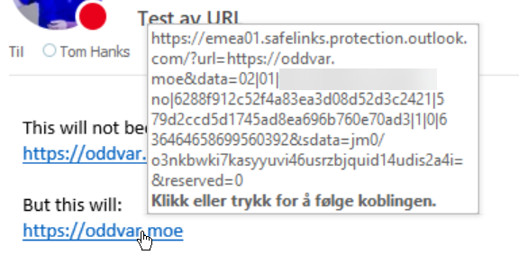
Office 365 ATP – Funker det?
Safelinks – Kjente svakheter
Notes:
Outlook link conversion

Slide 33
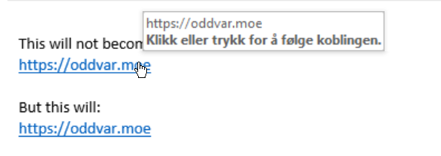

Office 365 ATP – Funker det?
Safelinks – Kjente svakheter
Notes:
Outlook link conversion

Slide 34
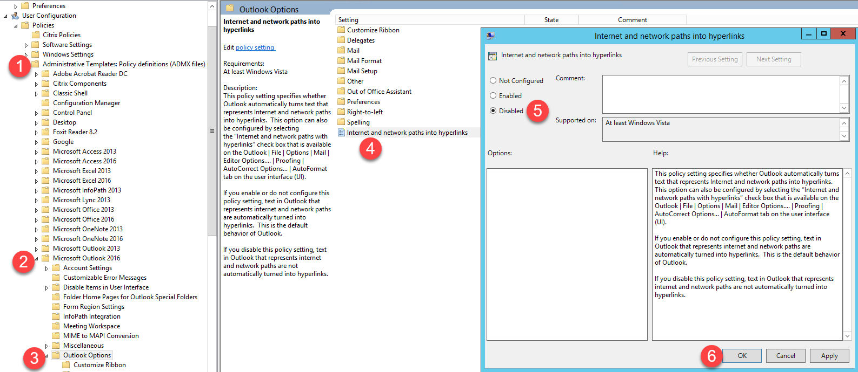
Office 365 ATP – Funker det?
Safelinks – Fiks - https://oddvar.moe/2018/01/03/office-365-safe-links-bypass/
Notes:
Outlook link conversion

Slide 35
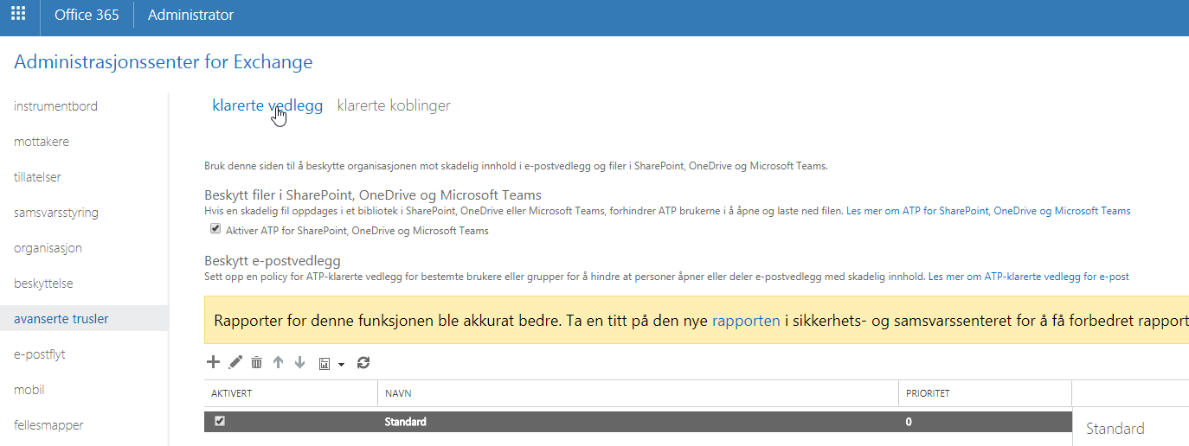
Office 365 ATP - Oppsett

Slide 36
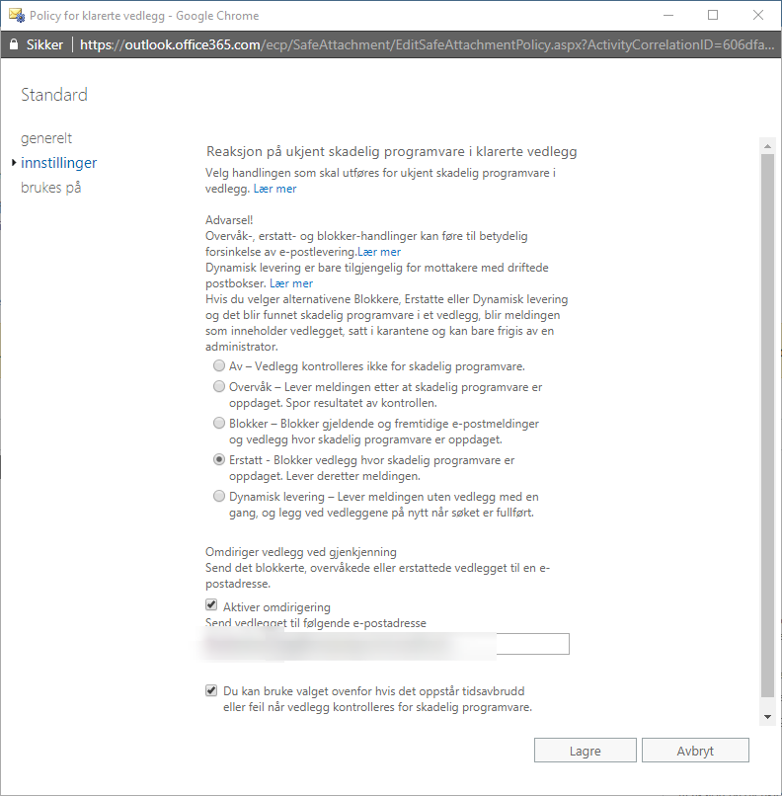
Office 365 ATP – Oppsett

Slide 37
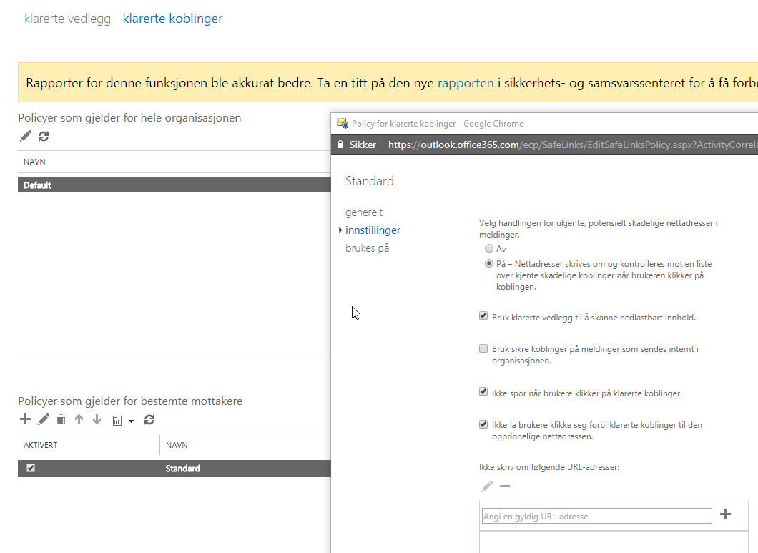
Office 365 ATP – Oppsett

Slide 38
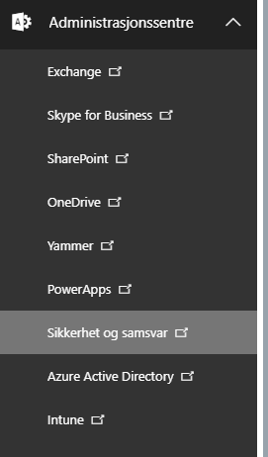
Office 365 ATP – Monitorering

Slide 39
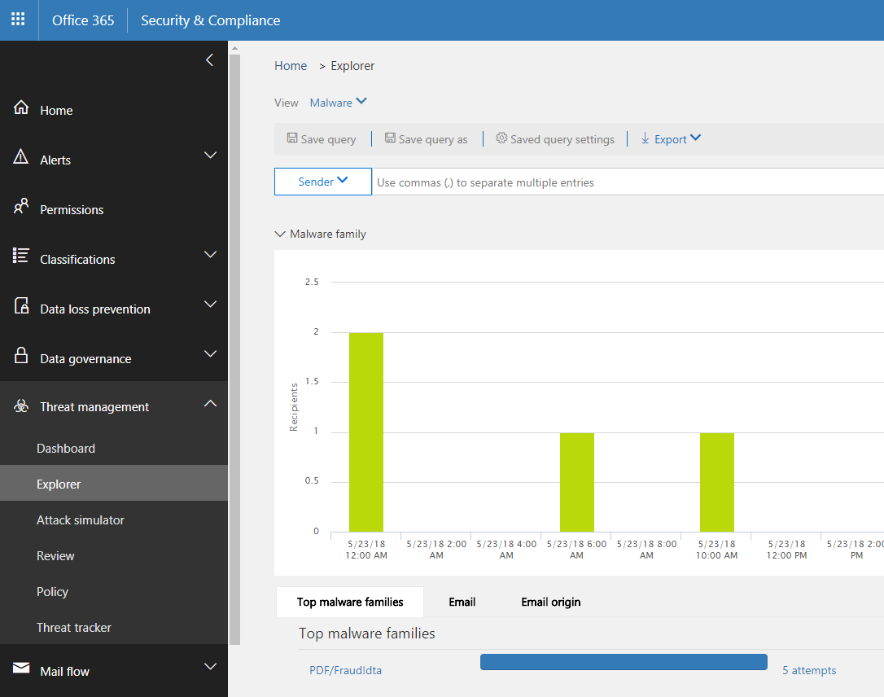
Office 365 ATP – Monitorering

Slide 40
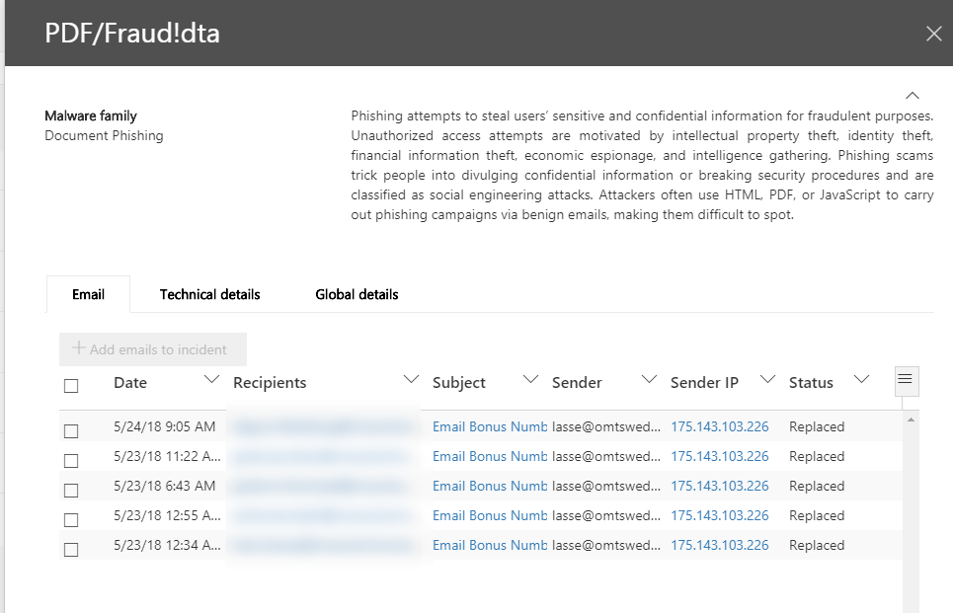
Office 365 ATP – Monitorering

Slide 41
Office 365 ATP – Monitorering

Slide 42
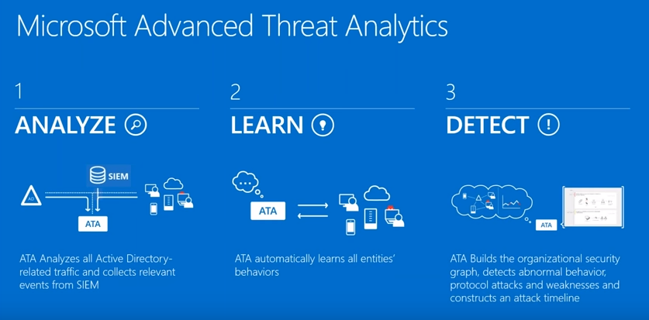
Azure ATP – Hva er det?
Sky versjonen av Microsoft ATA
Notes:
Oddvar

Slide 43
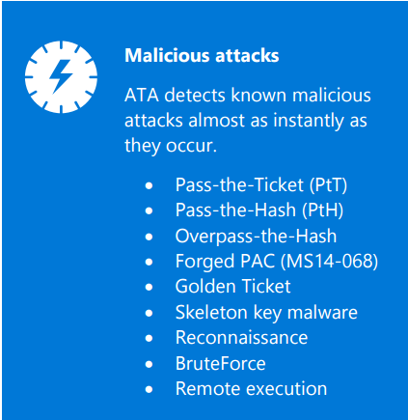
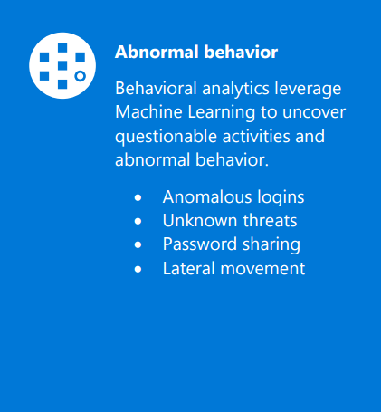
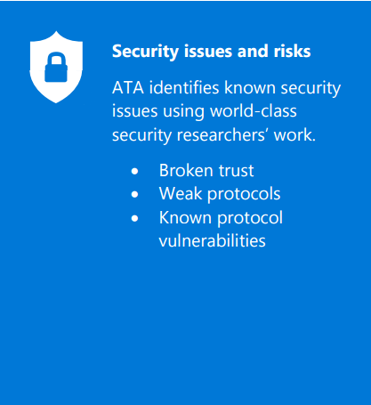
Azure ATP – Hva er det?
Sky versjonen av Microsoft ATA
Notes:
Oddvar

Slide 44
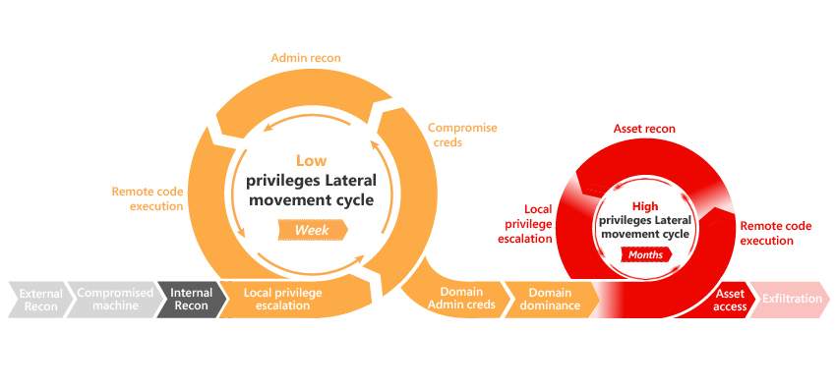
Azure ATP – Hva er det?
Notes:
Oddvar

Slide 45
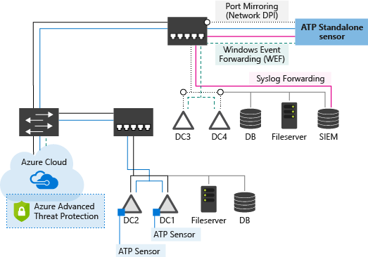
Azure ATP – Hva er det?
..
Notes:
Oddvar

Slide 46
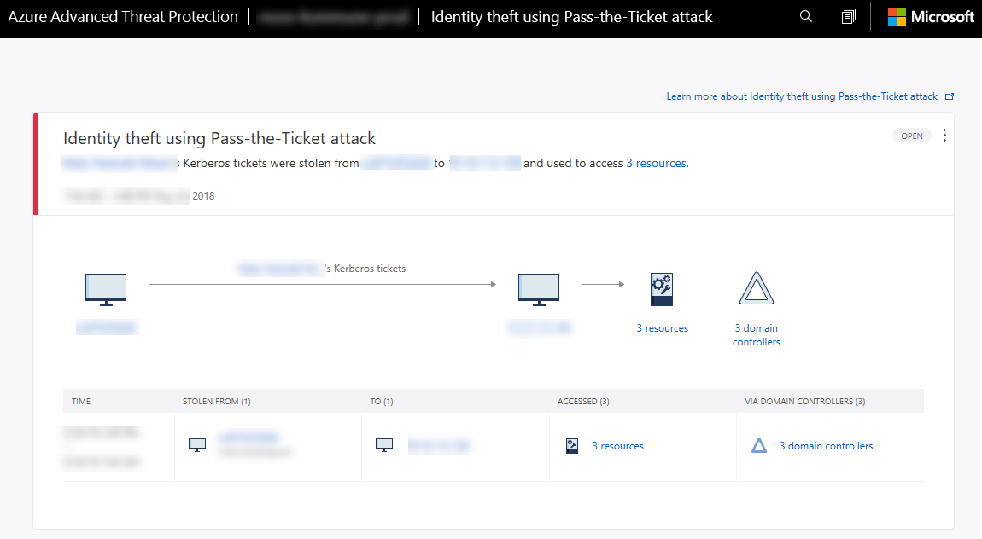
Azure ATP – Hva er det?
Notes:
Oddvar

Slide 47
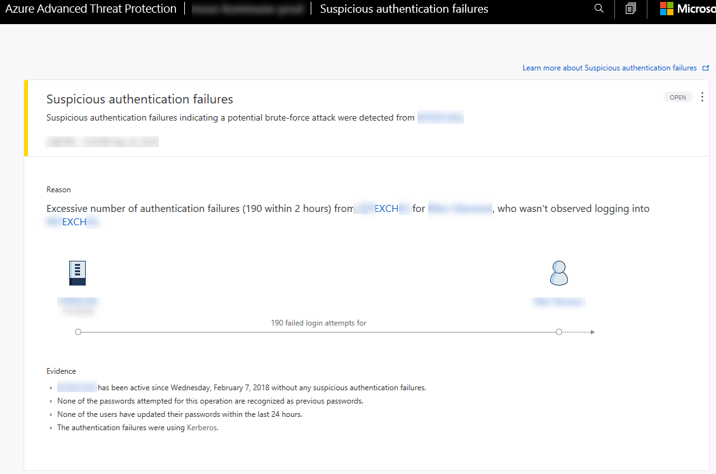
Azure ATP – Hva er det?
Notes:
Oddvar

Slide 48
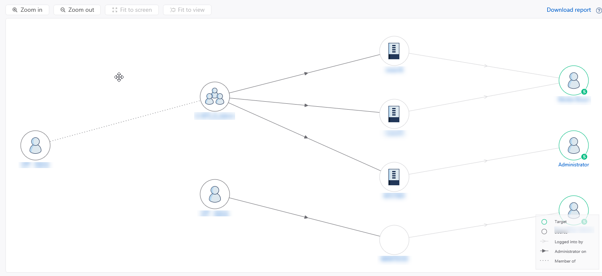
Azure ATP – Hva er det?
Notes:
Lateral movement paths – aka bloodhound

Slide 49


Slide 50
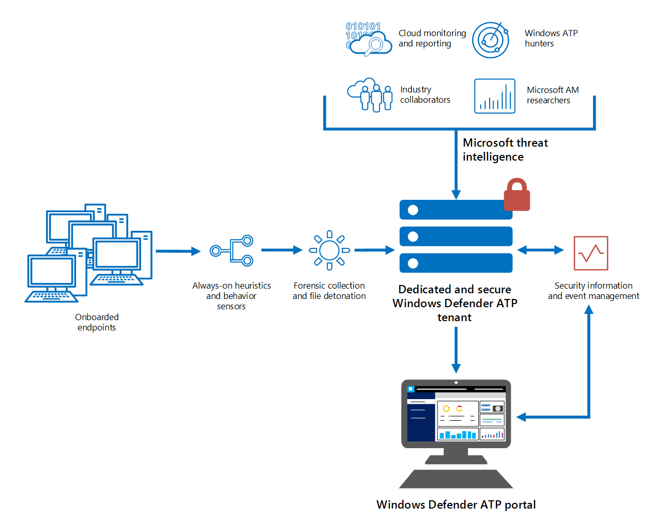
Windows Defender ATP – Hva er det?
..
Notes:
Oddvar

Slide 51
Windows Defender ATP – Hva er det?
Windows 10
Windows Server 2012R2
Windows Server 2016
Windows Server 1803
Windows 7 will come! (ILA sommeren)
Notes:
Oddvar

Slide 52
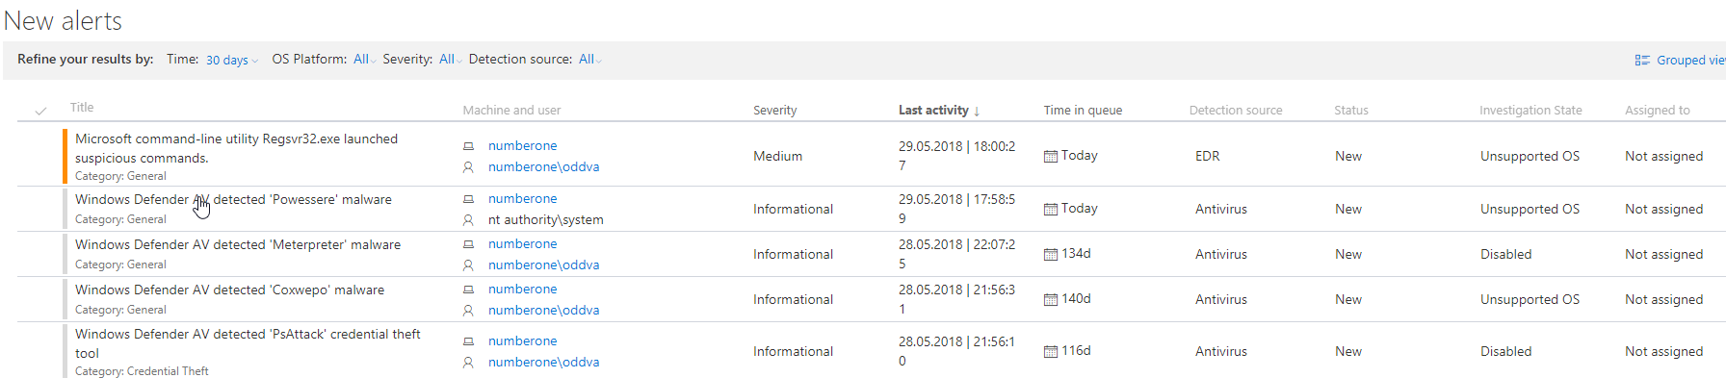
Windows Defender ATP – Hva er det?
Notes:
https://github.com/Microsoft/WindowsDefenderATP-Hunting-Queries

Slide 53
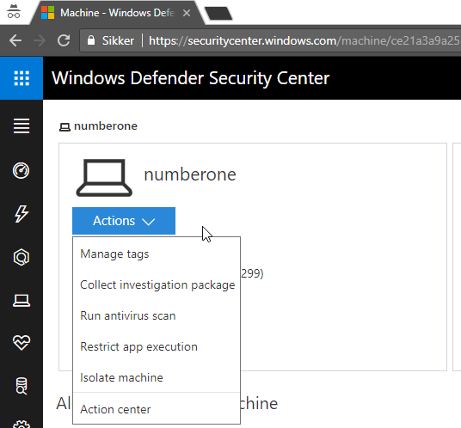
Windows Defender ATP – Hva er det?
Notes:
https://github.com/Microsoft/WindowsDefenderATP-Hunting-Queries

Slide 54
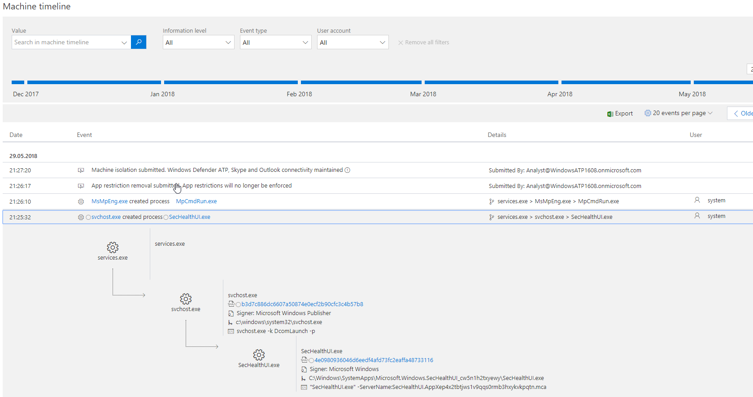
Windows Defender ATP – Hva er det?
Notes:
https://github.com/Microsoft/WindowsDefenderATP-Hunting-Queries

Slide 55
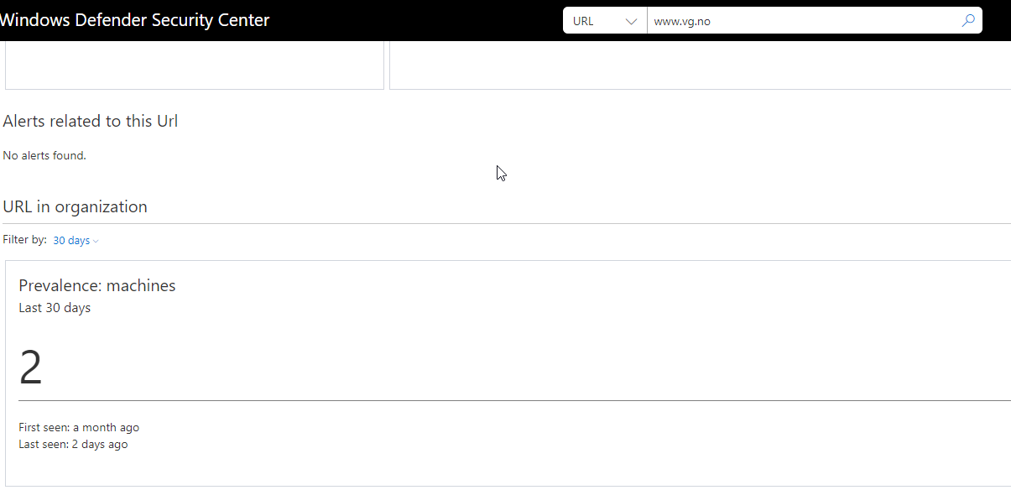
Windows Defender ATP – Hva er det?
Notes:
https://github.com/Microsoft/WindowsDefenderATP-Hunting-Queries

Slide 56
Windows Defender ATP – Hva er det?
Notes:
https://github.com/Microsoft/WindowsDefenderATP-Hunting-Queries

Slide 57
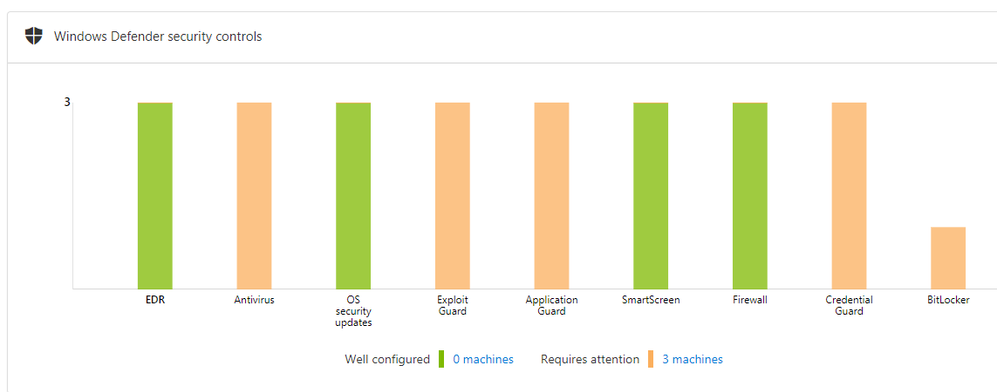
Windows Defender ATP – Hva er det?
Notes:
https://github.com/Microsoft/WindowsDefenderATP-Hunting-Queries

Slide 58
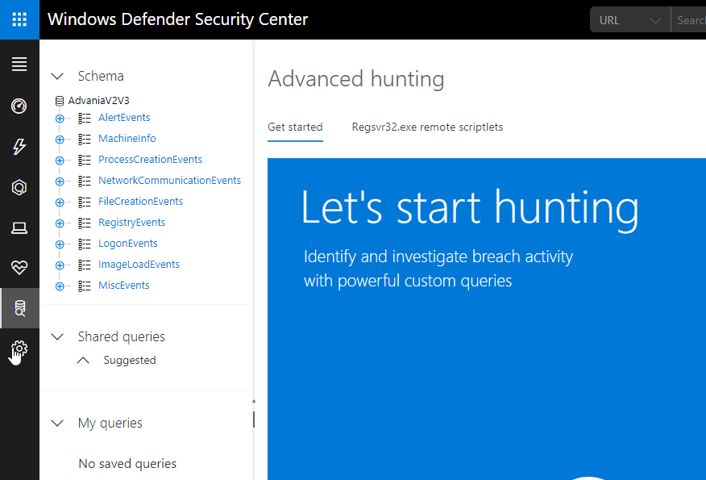
Windows Defender ATP – Hva er det?
Notes:
https://github.com/Microsoft/WindowsDefenderATP-Hunting-Queries

Slide 59

Windows Defender ATP – Hva er det?
Hva er threat hunt?
Finne ukjente trusler
Notes:
Oddvar

Slide 60
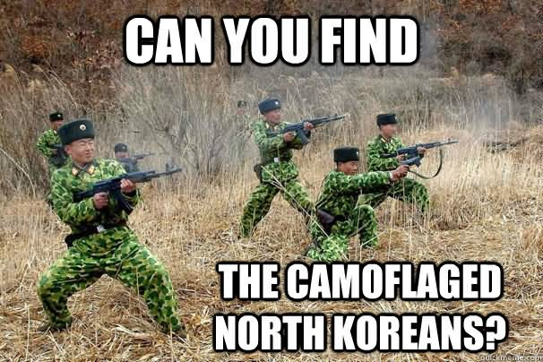
D E M O ! – THREAT HUNT
D E M O! - THREAT HUNT
Notes:
https://securitycenter.windows.com/dashboard
analyst@windowsatp1608.onmicrosoft.com
Hunting – regsvr32 remote scriptlets , files with double extensions
https://github.com/Microsoft/WindowsDefenderATP-Hunting-Queries

Slide 61
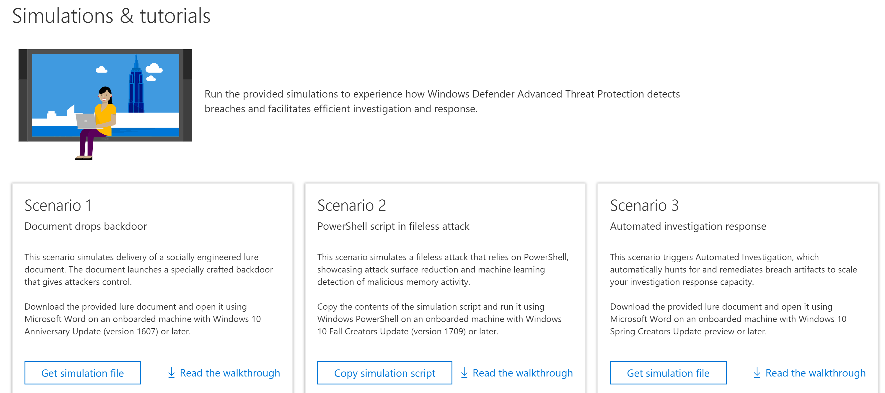
DEMO SCENARIO – WDATP + INTUNE + AAD CA
Beskyttelse i praksis med “JUST4CLICKS”

Slide 62

1. AKTIVERE INTUNE CONNECTION fra Windows Defender security center

Slide 63

2. Konfigurere WDATP innstillinger I INTUNE

Slide 64



3. Compliance Policy med risk score

Slide 65

4. AKSESS KONTROLL med Conditional Access

Slide 66

DEMO VIDEO

Slide 67




Tusen Takk for oss!
#MVPdagen
http://mvpdagen.no

